Slide 1
The Hidden Strengths of People who Stammer
Paul Brocklehurst
www.stammeringresearch.org
Notes:
Throughout my childhood and adolescence, if someone had asked me what impact stammering had had on me, my response would have been entirely negative. I would have focussed on how much it interfered with my ability to communicate and to interact socially with other people, and how it was preventing me from fulfilling my potential.
As I’ve grown older, and its severity has decreased, I’ve found myself increasingly able to contemplate the possibility that at least some of my earlier experiences of stammering may actually have been beneficial to me.
Anyway, this year, motivated by my own experiences, I decided to conduct a small survey asking other people who stammer to describe any positive impacts that stammering has had on their lives. My hope was that the survey might shed some light on a question that has been at the back of my mind for some time, which is... Is stammering associated with any positive attributes? In other words, do people who stammer have any special qualities or strengths?
This slideshow summarises the results.

Slide 2
This Talk
Does it matter?
Why might we have hidden strengths?
Previous research: What non-stammerers think
Stammerers’ Personal experiences – survey results
Conclusions
Notes:
Here’s a quick summary of what the slideshow covers...
First of all I want to say a few words about why this topic is an important one – both for people who stammer, and perhaps also for society in general.
Then I’ll discuss some of the reasons why it is likely that people who stammer do have some “hidden strengths”. By the way, I have described the strengths as “hidden” simply to emphasise that at least some of these strengths, if they exist, are probably not immediately apparent.
Then, I’ll briefly outline what previous research has been carried out that has looked at this question.
Then, I’ll discuss the findings of the internet survey that I carried out myself earlier this year.
Finally, I want to say a few words about how the findings of the survey potentially fit with what we currently know about the nature of stammering.

Slide 3
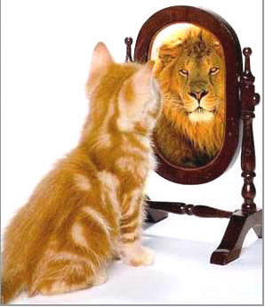
This topic matters!
Self-esteem
Social interaction
Employment
Effectiveness of therapy
Notes:
I want begin by saying a few words about how important this topic is and why it warrants our attention.
First of all, the understanding that stammering is associated with some beneficial attributes is likely to be good for our overall sense of self-esteem and this, in turn, can have an impact on how comfortable we feel with social interaction and our ability to portray ourselves in a positive light.
In addition to such general benefits, there is also an increasing body of evidence that suggests that speech therapy for stammering is more successful with clients who are more accepting of their stammering – and don’t regard it in a wholly negative light. A possible reason for this finding is that our capacity to resist the desire to avoid or to hide stammering is likely be strengthened if we can understand that stammering is associated with some positive – and potentially valuable – attributes. So yes, this definitely is a topic that is worth looking at.

Slide 4
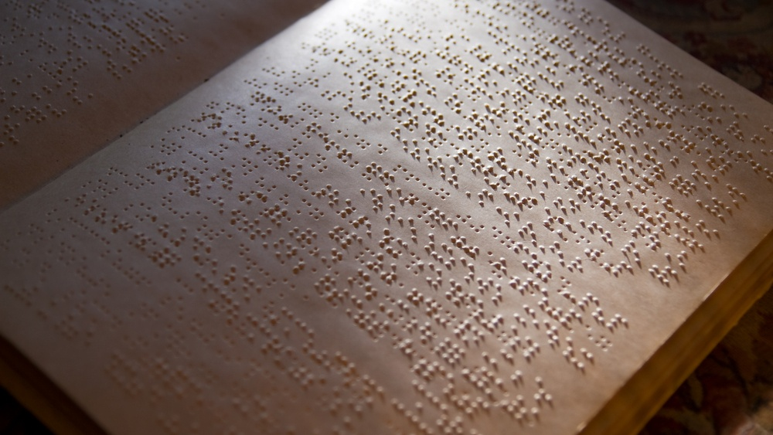
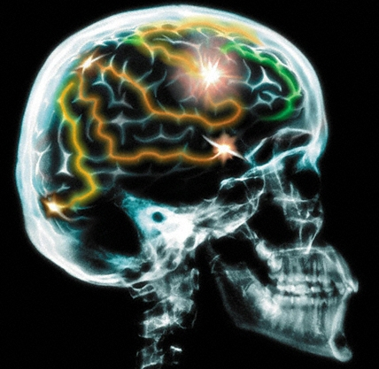
Brains compensate for impairment following injury or degeneration
Notes:
So, why might we expect that people who stammer may have some hidden strengths?
Perhaps the most obvious answer to this question has to do with the fact that the human brain is able to compensate for impairment in one domain by developing strengths in other domains.
There are many examples of such compensation. Perhaps one of the best known is how blind people frequently develop exceptionally acute senses of hearing and touch, and such sensitivity may enable them to excel at certain activities. So, for example, in Japan, many of the best practitioners of Shiatsu massage are blind.
Such compensations reflect “brain plasticity” - the brain’s ongoing capacity to develop and adapt to changing circumstances. It is noteworthy, however, that although such compensations may help affected individuals survive, overall those individuals still tend generally to be worse off than they would have been without the impairment.

Slide 5
But stammering is largely inherited
The genes that predispose to stammering may have some survival value
Notes:
There is, however, also another reason why we might expect stammering to be associated with some hidden strengths, that has nothing to do with brain plasticity and adaptation to impairment.
Namely, the fact that stammering is largely inherited - inasmuch as a strong predisposition to it is
passed on in our genes - suggests that the genes that predispose to it may well have some hidden survival value.

Slide 6
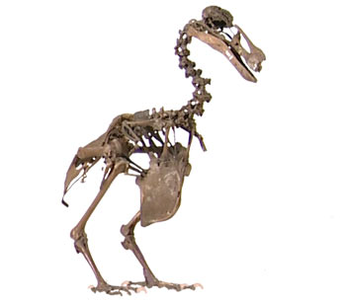
But stammering is largely inherited
The genes that predispose to stammering must have some survival value
Otherwise we would have died out
Notes:
Otherwise we would have died out.
To summarise – the finding that stammering is largely genetically inherited suggests that people who stammer have strengths that are more than just simply compensations for underlying weaknesses. On the contrary, it suggests that they have certain qualities that have some unique value – either to the individual or to the species as a whole.

Slide 7
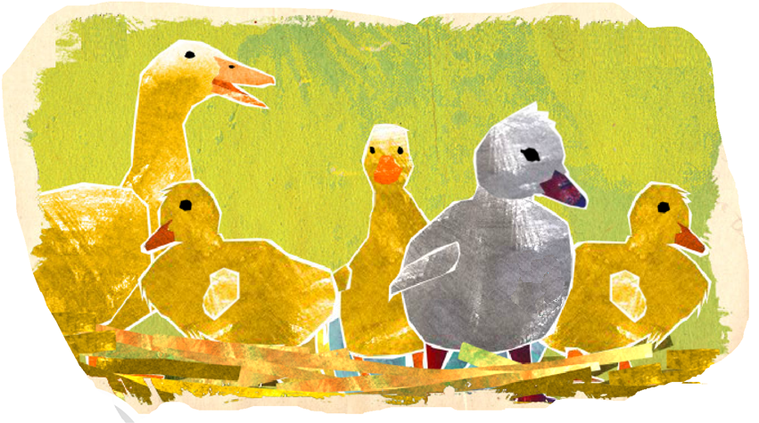
hidden strengths
Notes:
So, how is it possible that genes that predispose people to stammering may survive the process of natural selection? For a start, it’s important to recognise that a single gene can regulate a number of quite divergent attributes, some of which may be beneficial, while others may be detrimental. In such cases, if the beneficial attributes outweigh the detrimental attributes, the gene is likely to survive the process of natural selection, even though it may cause or pre-dispose to certain pathological conditions.
Also, it is possible that some attributes that are disadvantageous to us early on in life, may ultimately bring us long-term benefits. And, finally, although some attributes that we inherit may be detrimental to us, they may be beneficial to society as a whole.
Genes that code for such attributes may also survive the process of natural selection.

Slide 8
What do non-stammerers think?
http://www.stutteringattitudes.com/documents/Presentation%20pdfs/Hughes%20and%20Strugalla%20Survey%20of%20Public%20.pdf
Notes:
Before conducting my own survey, I did a literature search for any relevant work on the topic that already exist. I was unable to find any studies that investigated stammerers’ own perceptions of their strengths – or of positive aspects of stammering. However, I did find a poster describing a survey that was recently carried out by Hughes and Strugalla at the University of Toledo. The survey asked members of the general public to give their opinions of the strengths of people who stammer.

Slide 9
What do non-stammerers think?
Hughes & Strugalla
“Recognizing Positive Aspects of Stuttering: A Survey of the General Public”
Poster presented at Stuttering Attitudes Research Symposium (Morgantown 2013)
510 respondents (62% female)
Themes identified from participants’ responses...
PWS develop empathy and compassion for others.
PWS tend to focus on helping others.
Stammering results in personal growth or character strength.
PWS work to compensate for stammering.
Notes:
Four major themes were identified in participants responses, which were as follows...
PWS develop empathy and compassion for others.
PWS tend to focus on helping others.
Stammering results in personal growth or character strength.
PWS work to compensate for stammering.

Slide 10
Our survey of people who stammer 2014
Please describe any ways in which your experiences of stammering have had a lasting positive influence on your own life and personality.
describe any ways in which your stammering has had a lasting positive influence on the lives of other people you know or have come into contact with.
Notes:
Conscious of the Hughes and Strugalla findings, I then proceeded to design my own online survey that asked stammerers to describe their perceptions of any positive influence their stammering has had on their own lives and on the lives of others. The exact wording was...
“Please describe any ways in which your experiences of stammering have had a lasting positive influence on your own life and personality.”
And secondly ...”Describe any ways in which your stammering has had a lasting positive influence on the lives of other people you know or have come into contact with.”

Slide 11
Our survey of people who stammer 2014
28 Respondents (20 from the UK)
20 males, 8 females
Ages 17 -83
Mainly mild to moderate stammering (only one severe
Notes:
I emailed requests, to the British Stammering Association and also a number of other stammering self-help groups, for people who stammer to fill in the online questionnaire. In total 28 questionnaires were completed.

Slide 12
Our survey of people who stammer 2014
Notes:
It’s worth noting that stammerers who are in touch with self-help groups are generally quite well informed about stammering, and generally relatively accepting of their condition. So they may not be entirely representative of stammerers in the wider population.
As you can see here, the respondents included a mix of people with both covert and overt stammers.

Slide 13
ways in which stammering has had a lasting positive influence on your own life and personality
Notes:
Here’s a summary the most frequent responses to the first question...
As you can see, the most common responses involved empathy, receptiveness, sensitivity and/or awareness of others.
These responses directly from people who stammer are broadly similar to those elicited by the Hughes and Strugalla survey (which investigated the positive aspects of stammerers as perceived by the general public).
In the next few slides I’ve copied some of the more informative responses

Slide 14
Please describe any ways in which your experiences of stammering have had a lasting positive influence on your own life and personality.
I feel that stammering goes hand in hand with having a greater sense of empathy with others. I being hypersensitive to others perception of me, I have been able to become very attuned to what others are thinking and feeling.
I have also developed extremely strong language skills - possibly in part due to substituting and planning words and sentences in my head before speaking them.
Notes:
Here are some examples of participants’ actual responses to the first question...
I feel that stammering goes hand in hand with having a greater sense of empathy with others. I being hypersensitive to others perception of me, I have been able to become very attuned to what others are thinking and feeling.
I have also developed extremely strong language skills - possibly in part due to substituting and planning words and sentences in my head before speaking them.

Slide 15
Please describe any ways in which your experiences of stammering have had a lasting positive influence on your own life and personality.
having a stammer has enabled me to become a good communicator as I don't take the spoken word for granted, value communication in all its many forms and am a good listener.
It has given me patience, and empathy with others who have disabilities and struggle in life for various reasons.
Notes:
having a stammer has enabled me to become a good communicator as I don't take the spoken word for granted, value communication in all its many forms and am a good listener.
It has given me patience, and empathy with others who have disabilities and struggle in life for various reasons.

Slide 16
ways in which your stammering has had a lasting positive influence on the lives of other people
Notes:
Respondents had more difficulty suggesting ways in which their stammering may have had a lasting positive impact on the lives of others. All the same, some themes did emerge, the most common being that...
Stammering makes people more understanding of stammering/disability
It enables one to help other stammerers (via self-help groups)
It inspires others to achieve
It helps others open up

Slide 17
Please describe any ways in which your stammering has had a lasting positive influence on the lives of other people you know or have come into contact with
helps people to stop and think (as it takes time to listen to me!)
People often report feeling quite relaxed when talking to me as my vulnerability (i.e my stammer) is out-there for all to see
Notes:
Here are some of the comments...

Slide 18
Please describe any ways in which your stammering has had a lasting positive influence on the lives of other people you know or have come into contact with
over my life I have experienced that women find it actually endearing that I stutter.
...I think they get a motherly feeling over them and they seem to want to protect you
Notes:
I found this one particularly entertaining.

Slide 19
A note about causality
From a respondent...
I guess it's impossible to know what’s the cause and what’s the effect and what confounding variables are there?
Do I feel these positive things as a result of my daily experience of stammering, or would I feel these positive things even if I didn't stammer?
Do I just feel these positive things as a way to cope with my disability?
Notes:
Of course, It is important to remember that these responses reflect participants perceptions.
One of the participants made the following observation which nicely highlights the uncertainties regarding the causal relationships between stammering and the strengths that participants described...
It’s noteworthy that the two questions we posed in our questionnaire to participants asked people to describe strengths that have arisen as result of stammering, so it is possible that the wording of the questions may have influenced the causal inferences respondents made..
So for example, many participants said that stammering had increased their sensitivity towards other people. However, it is also possible that increased sensitivity may have been a predisposing factor that led them to start stammering in the first place – and it is also possible that both sensitivity and stammering may be the result of some other underlying factor.

Slide 20
Stammering and empathy
Is the experience of empathy stronger in stammerers than in people with other disabilities that entail a similar amount of difficulty and suffering?
Is the experience of empathy more accurate in stammerers?
Notes:
In the next few slides, I want to discuss in a bit more detail how and why some of the strengths mentioned by respondents might indeed be associated with stammering. Please bear in mind that much of this is theoretical, and has not been verified experimentally.
More than anything else, respondents equated stammering with the development of a high level of empathy.
When I have mentioned the association between stammering and empathy in talks that I have given, a number of people have suggested that perhaps any impairment that substantially increases ones experience of difficulty and suffering in life may lead to an increased ability to empathise with other people undergoing similar experiences. So perhaps an increased ability to empathise may be a strength found in people with disabilities generally, rather than being unique to people who stammer.
However, there is evidence that not all pathological conditions are associated with the development of increased ability to empathise. Indeed some conditions – such as psychopathy and autism – are characterised by a lack of ability to empathise. So, if stammering is indeed associated with a well-developed ability to empathise, we might predict that stammering should be relatively rare among people with psychopathy and autism. This should be relatively easy to verify experimentally.
Generally, the term “empathy” is used to describe two distinct abilities: the ability to “feel” what other people are experiencing (this is termed emotional empathy), and the ability to understand what other people are experiencing (this is termed cognitive empathy, and is closely associated with “theory of mind”).
The fact that respondents perceived themselves as highly empathic, reflects that they believe that they are particularly good at feeling or understanding what other people are experiencing. However, this does not automatically mean that their perceptions are accurate. It would be useful to research how accurate stammerers’ experiences of empathy really are. Are we really good at perceiving other people’s feelings and thoughts, or do we just think that we are?

Slide 21
Stammering and sensitivity
Sensitivity is essential for learning and adapting to change
Hypersensitivity in stammerers could be associated with high dopamine levels.
Stammerers may be at an advantage in old age.
Notes:
One of the most widespread beliefs about people who stammer is that they are generally “sensitive” people. So it is perhaps not surprising that many respondents cited sensitivity as one of their strengths
Sensitivity is essential for learning and for enabling us to adapt to changes in the world around us, and increased sensitivity is equated with increased intelligence. However, if someone is too sensitive – in other words, hypersensitive – it can significantly interfere with their ability to function in everyday life. Many people intuitively equate stammering with hypersensitivity and there are also a number of theories that consider stammering to arise as a result of various forms of hypersensitivity.
The extent to which people are sensitive to stimuli is regulated by neurotransmitters in their brains. In this regard it is noteworthy that people who stammer have been found to have abnormally high levels of the neurotransmitter dopamine.
Interestingly, dopamine levels in the brain are at their highest around the time of birth, and steadily decrease throughout life. This reflects the fact that the need for new learning and for the ability to adapt is at its highest during the first years of life, whereas once we’ve reached adulthood, we are able to function largely on the basis of the accumulation of past experience. Essentially, people become less sensitive as they get older and their dopamine levels decrease. This can become a problem as people approach old age, and find themselves no longer capable of new learning and unable to adapt to change.
In contrast, people who are highly sensitive are most likely to have problems in early childhood. As they get older, their levels of sensitivity reduce to more manageable levels, and when they get very old they are likely to remain sensitive and adaptive. Consequently, in old age, people who stammer may actually find that their sensitivity gives them an advantage over other people of the same age. This decrease in sensitivity with age may partially explain why stammering is so much more prevalent in early childhood – and why 80% of children who stammer have recovered by the time they reach their teens.

Slide 22
Stammering and creativity
Stammerers have been found to make more speech errors.
Their fine muscle movements may also be more variable than those of non-stammerers.
Errors and variability are the basis of all creativity.
It is likely that people who stammer are particularly creative.
Notes:
Finally, I want to say a few words about the relationship between stammering and creativity, as this is a topic that is closely related to my own area of research – which is the relationship between stammering and speech errors.
A major part of my PhD involved an investigation of the frequency with which people who stammer make mistakes when speaking. As a part of this investigation, we got a group of stammerers and a matched group of non-stammerers to repeat tonguetwisters over and over, and we asked them to stop, each time they noticed themselves making a mistake. Overall, the stammerers self-reported about twice as many mistakes as the non-stammerers. So, for example, stammerers were twice as likely to mix up the sounds that the words began with and they were more than twice as likely to accidently say the words in the wrong order. Interestingly, it wasn’t just when speaking out loud that they were more error-prone – they were also more error prone when saying the tongue-twisters internally, inside their heads. Other studies have found similar results, and it is likely that this error-proneness of people who stammer is not confined only to their speech. So, for example, some studies that have investigated the accuracy with which stammerers are able to make repetitive jaw and finger movements have also found that their movements are more variable than those of people who do not stammer.
On the one hand, this error-proneness may be seen as a handicap. However, the tendency to make errors and the tendency for our performances to vary also has a positive side to it... in as much as it forms the basis of much of our creativity. Essentially, if we never made errors, we would be far less likely to discover new and different ways of doing things. Much of the richness of human culture, including aspects as diverse as art, music and technological innovation stems from our tendency to make errors.
There are now a number of theories of stammering that posit that stammered disfluencies stem from our attempts to avoid or correct our speech errors. These theories predict that the more we try to prevent ourselves making speech errors, the more disfluent we become. Unfortunately, as long as we perceive speech errors as fundamentally undesirable, it is very difficult not to try to avoid or prevent them. However, if we could come to perceive our speech errors – and our general error-proneness – in a more positive light, as the source of our creativity, we may find that what previously appeared to be a weakness – inasmuch as it causes us to be disfluent – in fact also has the potential to be one of our key strengths. To the extent that we can learn to embrace our tendency to make errors, we become able to realise the full extent of our creativity. It could well be that this creativity ultimately turns out to be our most valuable asset.

Slide 23
Conclusions
Respondents identified a variety of strengths associated with their stammering and a number of ways in which their stammering had a positive impact on others.
Although inline with theoretical predictions, the survey findings need objective experimental verification.
In particular, future research could profitably investigate the relationship between stammering and empathy, sensitivity and creativity.
Notes:
So, finally, to wrap things up, what can we conclude from this study?
Well, first of all, it is important to bear in mind that this is just a preliminary, exploratory study, involving only a relatively small number of participants. So we need to be cautious not to over-interpret the findings.
Having said that, the respondents did identify a variety of strengths associated with their stammering and a number of ways in which their stammering had a positive impact on others, some of which were inline with what we would predict on the basis of current theories of stammering and experimental findings.
The relationship between stammering and the strengths reported by respondents needs to be researched experimentally to determine the extent to which the respondents’ perceptions are accurate. In particular, future research could profitably investigate the relationship between stammering and empathy, sensitivity and creativity.

